Slide 1
Bel Brands USA Little Chute, Wisconsin Pursuing the highest standards of food safety and quality

Slide 2
FSSC 22000
The “Super Bowl” of Food Quality & Safety

Slide 3
A 2-year Quest
FSSC 22000 Certification:
More than a process change, it is a fully integrated Food Safety and Quality System across the entire supply chain from vendors to consumers.
Initially based on ISO 22000, the global food safety management system standard.
Fully recognized by the Global Food Safety Initiative (GFSI).
“The only place success comes before work is in the dictionary.” -Vince Lombardi

Slide 4
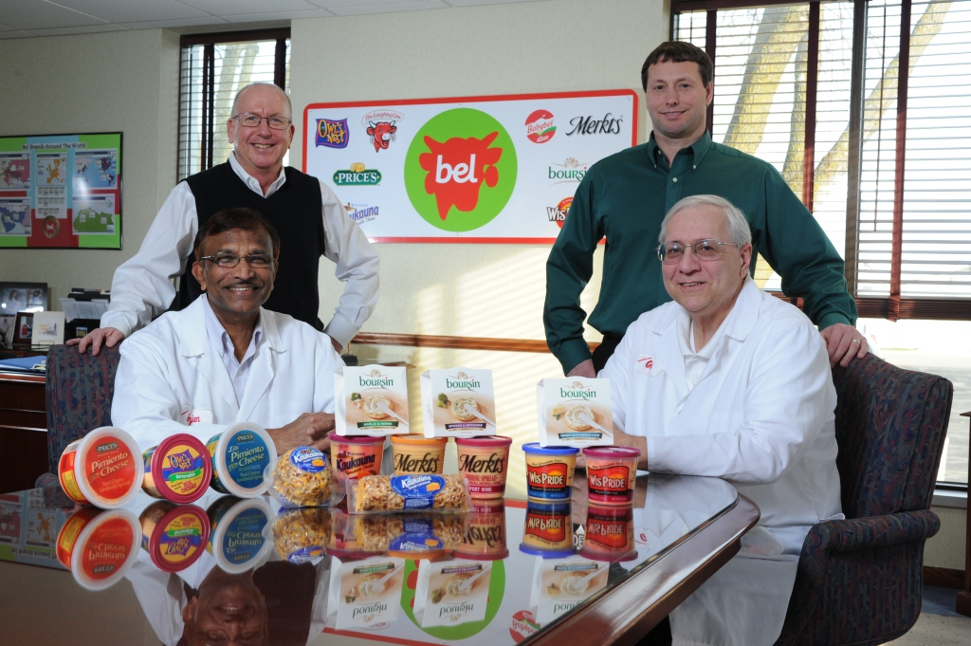
Step 1: Assemble the Team

Slide 5
Our Team
Ed Blascak – Director of Operations
Anjan Reddy – Director of Research & Development
Mark Riemer – Manufacturing & Supply Chain Manager
Kelly Suprise – Quality & Regulation Manager
Greg May – Quality Services Manager
Jeff Weiland – Senior Production Supervisor
...and 150+ dedicated plant employees!
“The achievements of an organization are the results of the combined effort of each individual.” -Vince Lombardi

Slide 6
Stage 1: Game Plan

Slide 7
Creating the Game Plan
Stage 1 - The Pre-Audit
A self-evaluation to see where you stand
Gap Analysis
Helps to prioritize and identify the systems, procedures and processes needed to become FSSC certified
Purchasing to Manufacturing
Documents & Records
HACCP Plan
Labeling & Traceability
Internal Audit & Corrective Action Plans
Emergency Preparedness & Response
Management Responsibilities

Slide 8
Typical Food Safety Management System Documentation Hierarchy
1
2
3
4
Food Safety Policy, Objectives, Risk Assessment
HACCP, PRPs, oPRPs
Describes how tasks and specific
activities are done – SOPs, WI
Provide objective evidence of conformity to FSMS requirements
(Records, Equipment Manuals, etc.)

Slide 9
FSSC 22000 Process Model
Verification
Monitoring, Corrective Actions
Improvement
Implementation
ISO 22000:2005 Process Model
Planning and realization of safe products
Establishing HACCP Plan
Preliminary Steps to enable hazard analysis
Hazard Analysis
Validation of Control Measures
Establishing Operational PRPs

Slide 10
Training Camp
Employee Training
A high-seniority plant - years of experience on the job
Documented and updated training
Basics on how to perform job correctly
Everyone in the plant had to be retrained
Drills & Practice
Muscle memory-Do it the exact, correct way every time
Plan for the unexpected
“Winning is not a sometime thing, it is an all the time thing. You don’t do things right once in a while…you do them right all the time.” -Vince Lombardi

Slide 11
The Cost of Quality
Brought in 3rd Party Expert to Validate FSSC Readiness
Engaged a Food Safety and ISO expert from
Wisconsin Manufacturing Extension Partnership
Update, Upgrade, Repair, Replace
Equipment, Physical environment, Interior/Exterior
5% - 10% of CapEx budget

Slide 12
Stage 2: Game Time

Slide 13
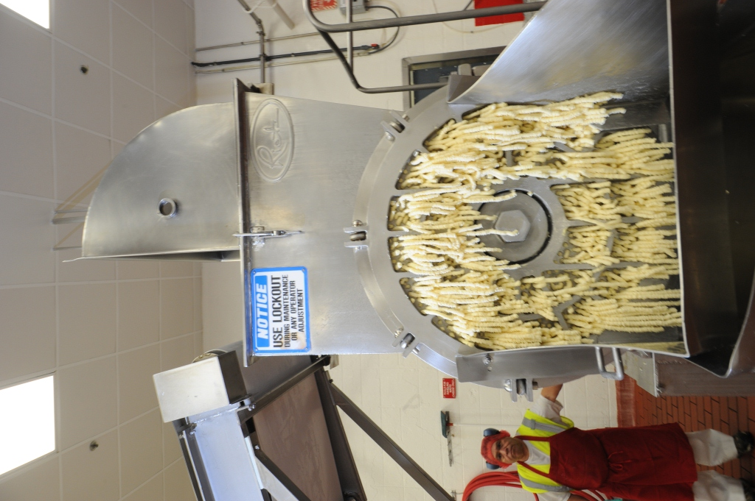
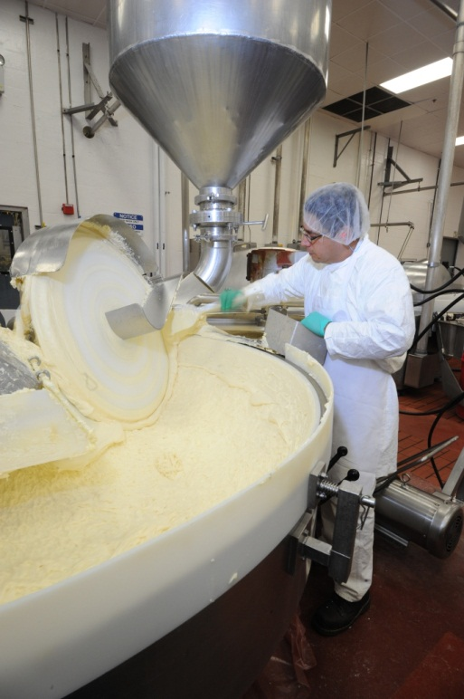
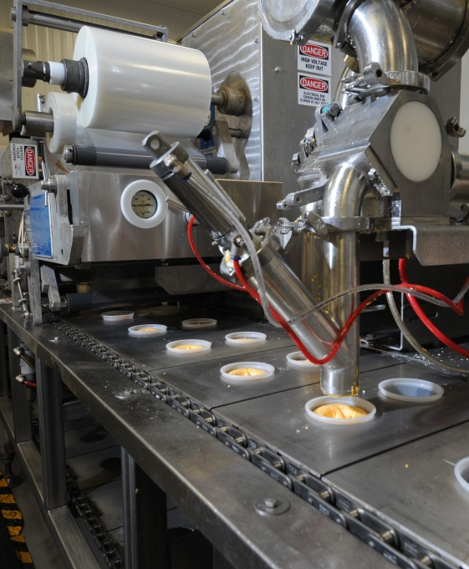
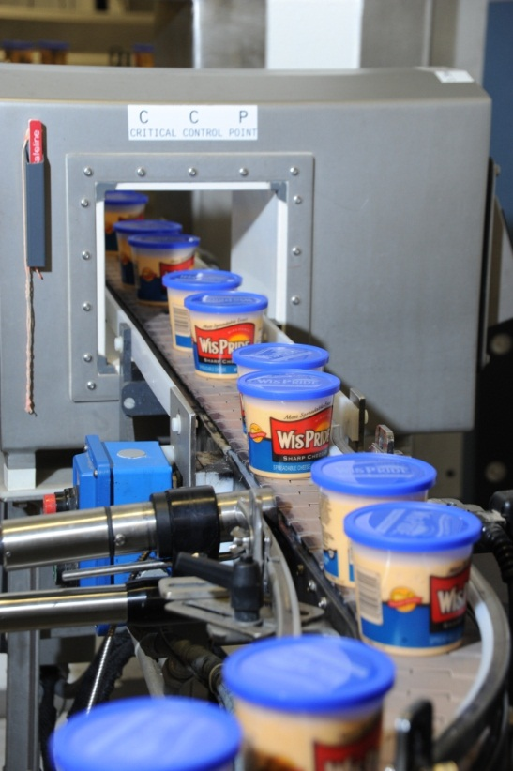
Stage 2 Audit - Certification
Must occur within 6 months of Stage 1 Audit
2-3 day whole plant audit process
Documentation review & validation
Management & employee interviews
Address major and minor non-conformities

Slide 14
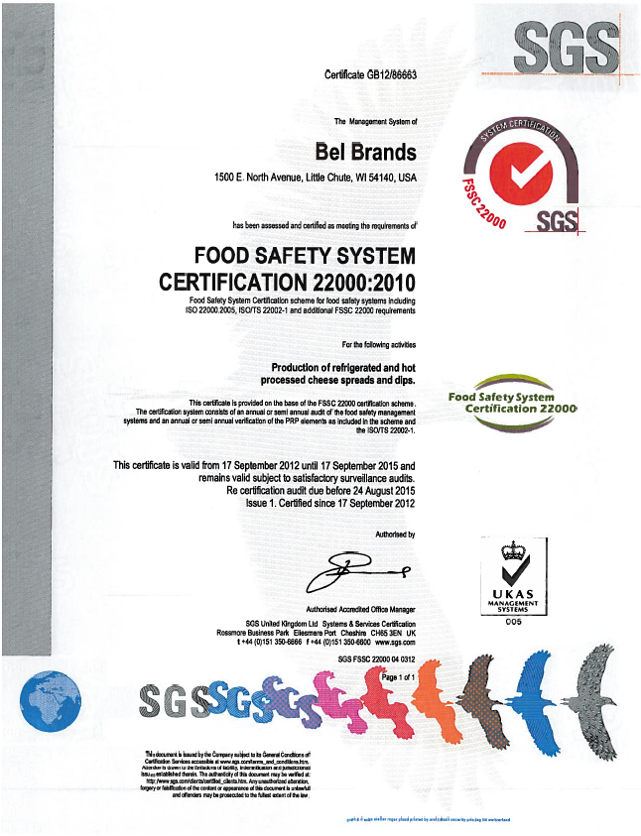

Slide 15
The Benefits...
Product Excellence
Consumer complaints are down 60%
Improved Safety
Safety audits rose from mediocre to one of the best
Accidents reduced by 50%
1 year no loss-time injuries
Reduced Waste
Total Plant “Transformation”
Overall appearance of plant
Employee pride

Slide 16
FSSC Certification
Measures of Continuous Improvement
Communication
Management Reviews
Internal Audits
Corrective Actions
Evaluation of Verification Results
Validation of Control Measure Combination
Updating the FSMS
“Perfection is not attainable. But if we chase perfection, we can catch excellence.” – Vince Lombardi

Slide 17
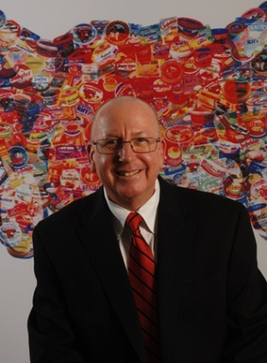
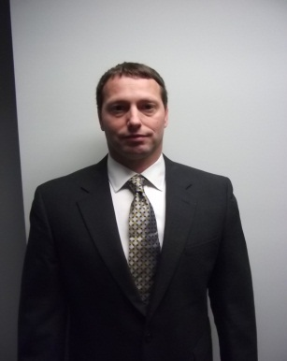
About the Presenters
Ed Blascak, Director of Operations, Little Chute, Wisconsin, Bel Brands USA. Ed leads the Bel Brands USA Little Chute plant in producing award winning Merkts, Kaukauna, Wispride, Owl’s Nest, and Boursin spreadable cheeses, along with, Prices pimento sandwich spread. Ed joined Bel in 1999 as the Manufacturing Manager in Little Chute and has been Plant Director since 2010. In 2012, Ed and his Little Chute team achieved FSSC 22000 certification, one of the highest standards for global food safety. The plant was re-certified for FSSC 22000 in 2013.
Ed has 30 years of food industry experience and was previously responsible for multiple plants as Plant Manager with Stella Foods, Inc. He served six years travelling the world with the United States Navy. Ed earned a Bachelor of Science degree in Business from Salve Regina University in Newport, Rhode Island.
Mark Riemer, Manufacturing and Supply Chain Manager, Little Chute, Wisconsin, Bel Brands USA. Mark manages the manufacturing and supply chain functions at the Bel Brands USA Little Chute plant. Mark joined Bel in 2007 as Procurement Manager and has been Manufacturing and Supply Chain Manager since 2011. Mark is one of the FSSC 22000 team leaders and was part of the FSSC 22000 implementation team.
Mark has 20 years of purchasing and manufacturing experience with 17 years in the food industry. Mark previously worked at Anchor Food Products as Co-Pack Purchasing Manager, where he was responsible for negotiating agreements and managing the co-pack supplier base. Mark earned his Masters of Business degree from University of Wisconsin-Oshkosh, Oshkosh, Wisconsin.

Slide 18
Thank you!

